Slide 1
Computer Integrated Manufacturing
Course Project
Harishkumar
190030017

Slide 2

Input Data
Stock height
The height of the workpiece to be machined
Radius of the Tool tip
Required Scallop height
Required Chordal Error
4x4 matrix of points:

Slide 3
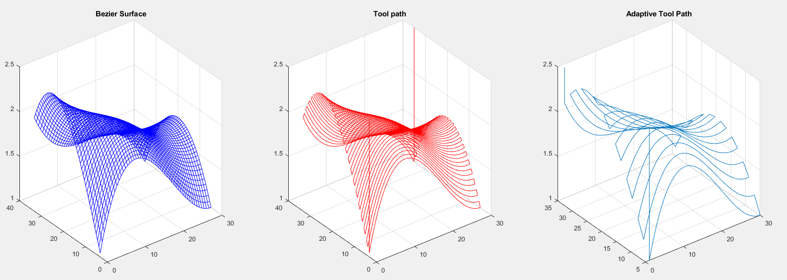
OutPut
The following allowing with the necessary GCode for adaptive tool Path

Slide 4
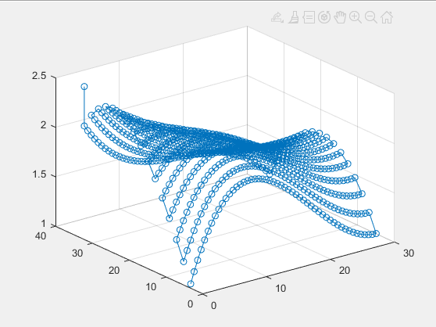
Bonus
Almost simulates the code

